Slide 1
Food Wastage Management
Banarsidas chandiwala institute of information technology
Prepared by: Guided By:
Harsh gupta sushma bhaguna ma’am
02411104420

Slide 2
INTRODUCTION
Food management system is the process in which we can deliver food to the poor, the food that is thrown by big hoteliers and the food that is thrown in big offices, it is designed to deliver the food to the poor.

Slide 3
Problem Statement
Food wastage is a massive problem and one of the most overlooked thing in today’s world
One third of all food produced in the world goes to waste
Some restaurants/cafés have a policy to not serve food from previous day, despite being perfectly edible. This is all thrown away as “waste”, at the end of day.
Roughly $400B in food ends up in landfills every year resulting in 3.3 billion metric tons of greenhouse gases annually which has multiple effects on the world
At the same time, worldwide nearly 800 million people do not have enough to eat. That means one in nine people are suffering from hunger. Hunger and malnutrition are the number one risk to health worldwide.
Our application provides a way to bridge the gap between the wastage and deficit, by letting restaurants donate this food to NGOs, who in turn can feed the needy

Slide 4
Approach
We have designed a system to curb the wastage by managing the flow of food going waste by redirecting it from the restaurants to the needy people
For this we have different organizations like Restaurants, NGOs, Logistics who working in unison to achieve this goal
Restaurants raise requests for food collection, which are passed onto all NGOs within the network
These requests must however contain food which are not going to be perished immediately(show be consumable at least 4 hours)
Based upon the feasibility of the request, any NGO can pick-up the request and assign it to any logistics partner within the network
These logistics organizations then complete the pick-up from the requested restaurant, and deliver it to the requested NGO
NGOs can also raise a request with other NGOs within the network for an inventory shortage, and subsequently any NGO can then redirect restaurant requests to the particular NGO facing shortages
Logistics charges the requesting NGO for the deliveries, sending them invoices which are then paid for by the NGO
A Mayor can view all the activities within the different Enterprises in their network (Like amount of food wastage avoided by restaurants, people fed by NGO, expenses incurred by them in doing so, etc.)

Slide 5
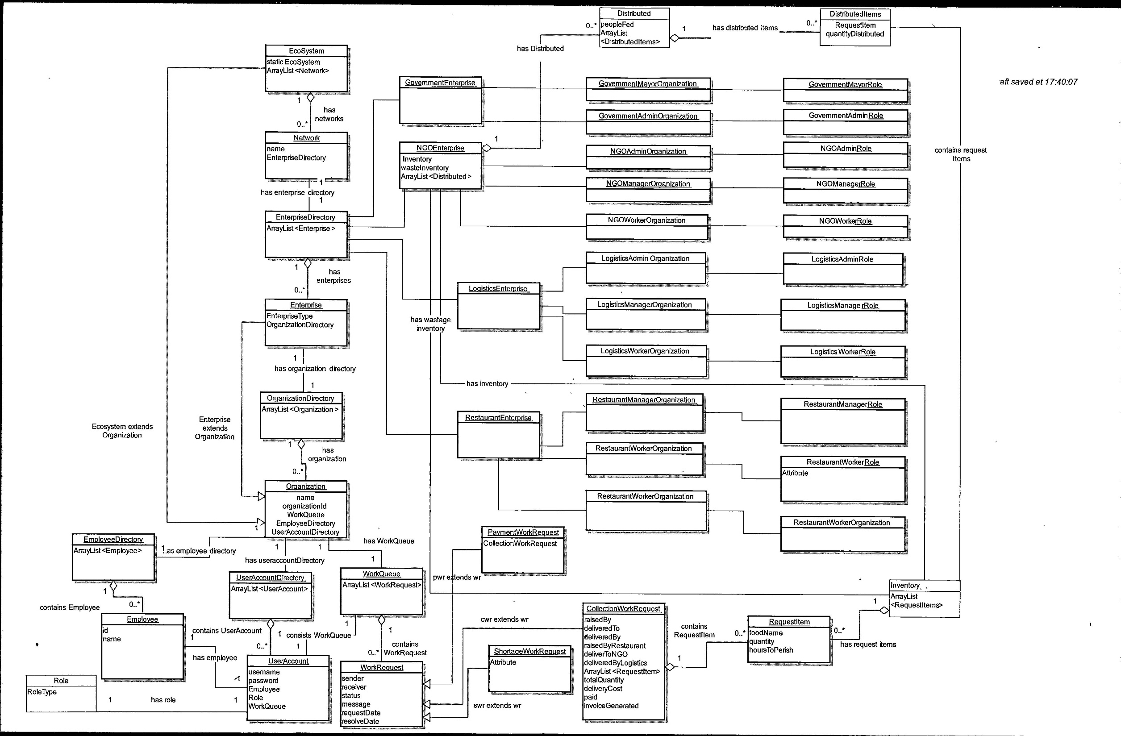
Object Model

Slide 6
Use Case
Use Case 1 : Collection Request
A restaurant/café worker creates a collection request for excess food, which is then sent across to all the NGOs within the network
An NGO manager can view all the request raised by restaurants for pick-up and assign it to an employee in their enterprise, who will then proceed with the collection of the delivery and updating the inventory
If the NGO manager feels they have sufficient food in the inventory and sees a shortage request from other NGO, they can directly assign it to the NGO for further processing
After either of the 2 cases, the request is then forwarded to logistics manager’s queue
Any logistics manager can pickup the request and assign it to one of their employee
The said employee then picks up the package from the requested restaurant and delivers it to the NGO
A delivery cost is assigned to the on delivery completion
The NGO worker collecting this request then updates the enterprises’ inventory with the food delivered

Slide 7
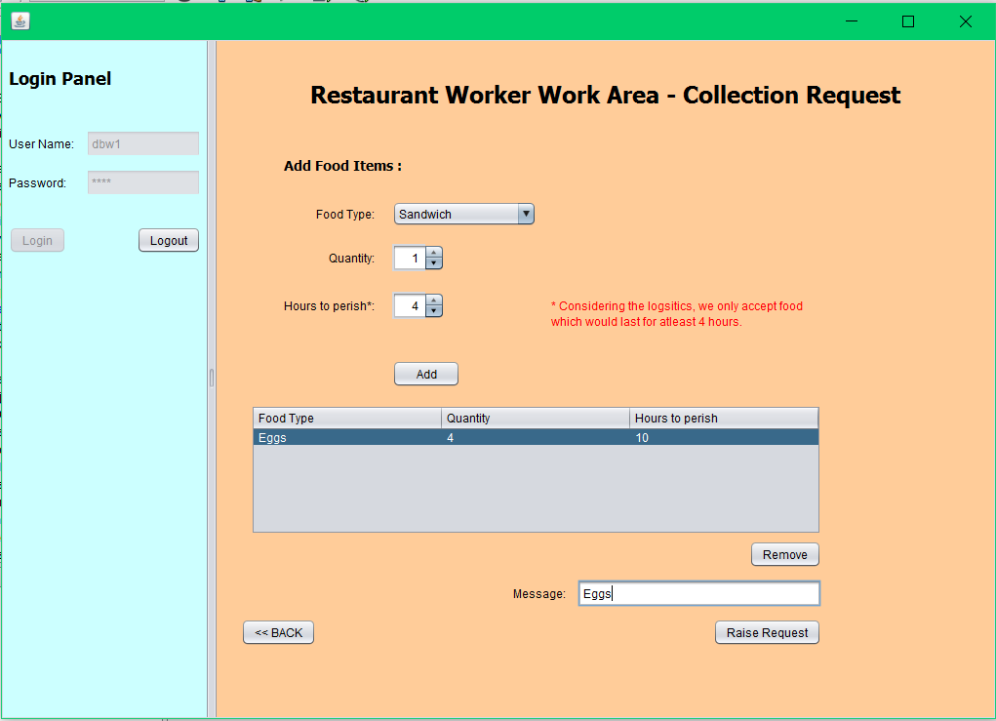

Slide 8
Use Case
Use Case 2 : Invoice Request
After a successful delivery, a delivery cost is provided against it
A Logistics manager can then generate an invoice for all successful deliveries made by their enterprise, to a particular NGO
This request is then forwarded to the respective NGO’s manager who would then be responsible for the payment of the same

Slide 9
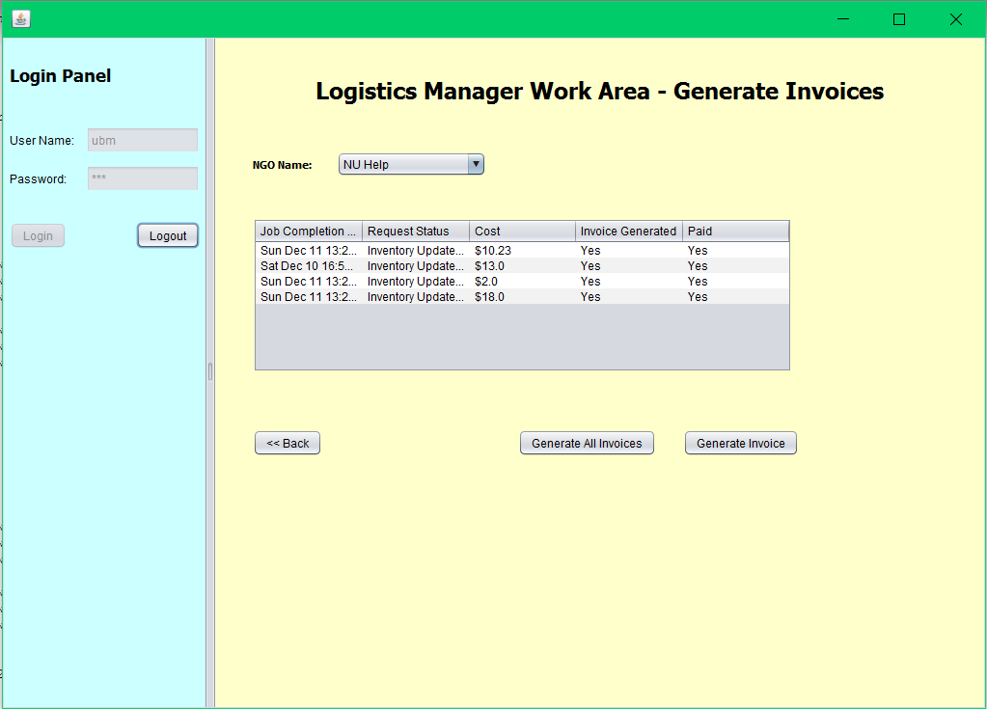

Slide 10
Use Case
Use Case 3 : Shortage Request
An NGO manager while viewing the enterprises’ inventory can raise a shortage request
The manager also mentions an employee who would then follow-up on the request
This request is then forwarded to all other NGO managers within the network
An NGO manager can then redirect a particular collection request to an NGO facing a shortage
The logistics and collection then proceeds like a usual collection request
This collection request is linked to the original shortage request

Slide 11
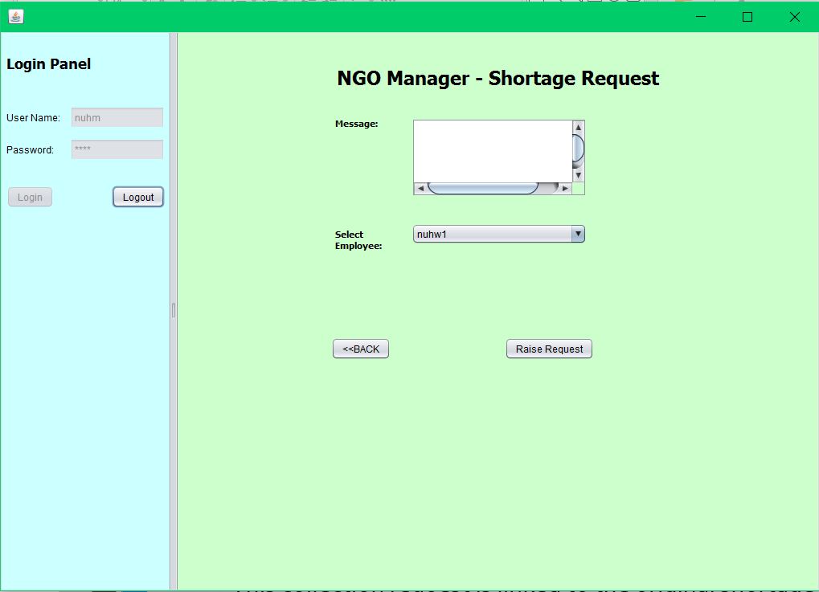

Slide 12
Use Case
Use Case 4 : Food distribution
Any NGO employee(worker) can distribute food to people from the collection.
The employee can view the inventory, as well as the time before which the particular food item would perish
This way, maximum wastage can be avoided
The number of people fed are then updated after a particular distribution

Slide 13
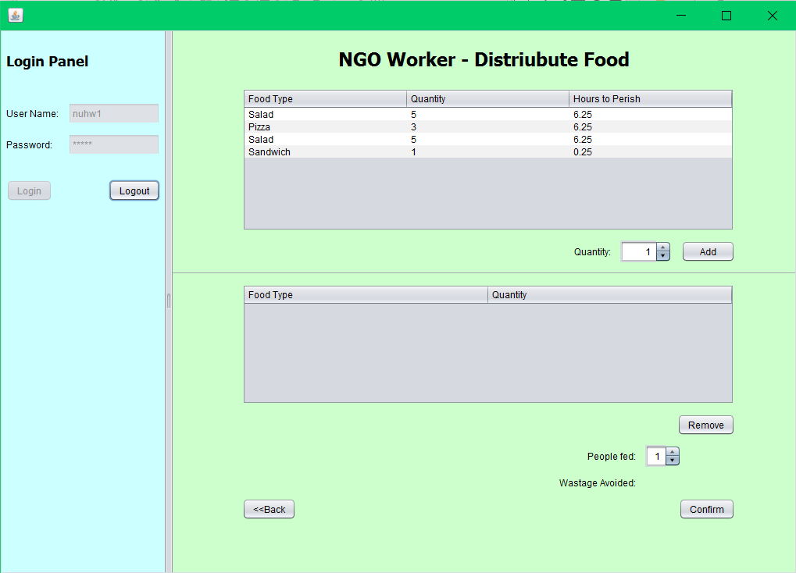

Slide 14
Use Case
Use Case 5 : Perishable time update
Whenever the application runs, it browses through all the requests raised and updates the perishable time on a particular food item
Whenever a food item in an NGO’s inventory is perished(i.e., time to perish becomes 0), then item moves from the inventory to the wastage inventory
The wastage inventory helps keep track of the wastage in a particular NGO
This can help in redirecting some requests to other NGOs who generally would face shortage of food

Slide 15
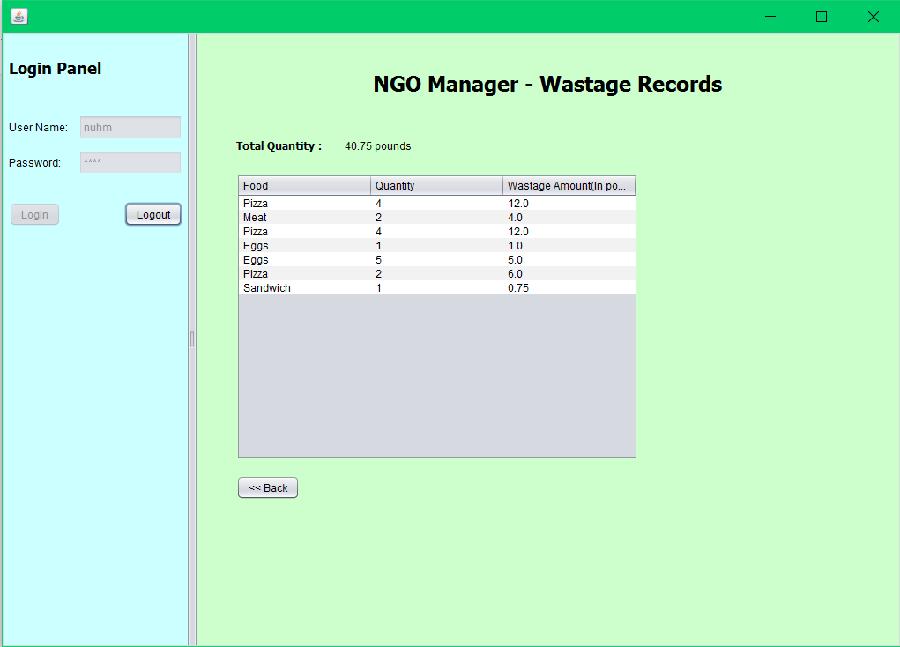

Slide 16
Use Case
Use Case 6 : Mayor
A Mayor can view the interactions between the various enterprises within their network
This would help them understand restaurants which donate their leftovers and help avoid wastages
In terms of NGO, help understand which NGO is helping feed people
Mayor can also check the expenses incurred by the NGOs in helping avoid wastages. This might help the Mayor allocate some funds to the NGO(future scope)

Slide 17
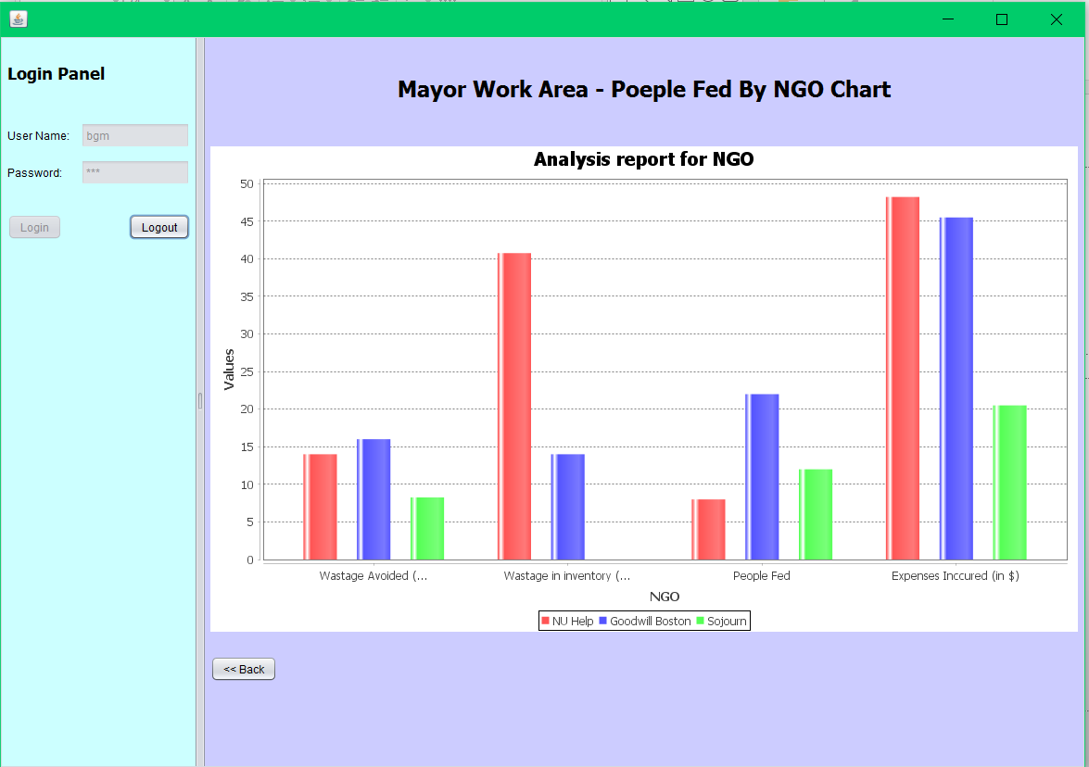

Slide 18
Architecture Diagram

Slide 19
Future Scope
Instead of just restaurants/cafés we can also have people register themselves in the application to donate leftovers from parties/weddings
Mayor can allocate funds to NGOs
Ability to add non-perishable food. This can then be sent across to other network in case of any disasters resulting in shortage of food
An ability of 1-1 tie-up between restaurant, NGO, and Logistics for pickups everyday

